Slide 1
Introduction to Image Analysis with FIJI
2. Segmentation &
Filters, Morphological Operations
Noreen Walker, Gayathri Nadar
Scientific Computing Facility, MPI-CBG
3.-7.5.2021
Aim of this session:
Segmentation introduction
Classic segmentation pipeline, interactive segmentation
Provide mathematical background for operations on images:
Image filters, Morphological operations, Image math
With material from:
Robert Haase
Benoit Lombardot

Slide 2
Course schedule
Day 1 (Mon 3.5.)
Image basics, visualization, measurements
Spot detection
Segmentation (start)
Day 2 (Tue 4.5.)
Visit LMF
Segmentation (cont’d)
Mathematical background: image filters, morphology
Day 3 (Wed 5.5.)
Advanced segmentation: Machine learning with Ilastik
IJ Macro (start)
Day 4 (Thu 6.5.)
IJ Macro (cont’d)
3D data: visualization and analysis
Day 5 (Fri 7.5.)
Image registration, image stitching
Time sequence analysis and tracking
Good practices

Slide 3
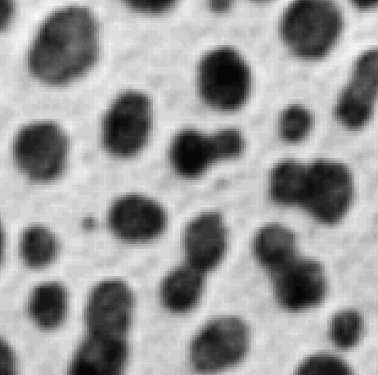

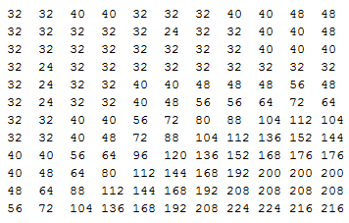
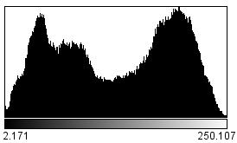
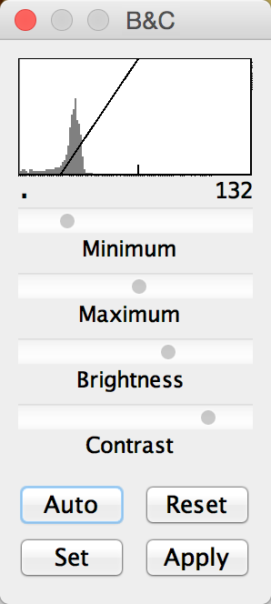
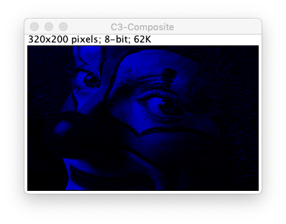
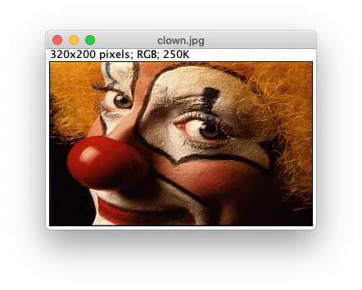
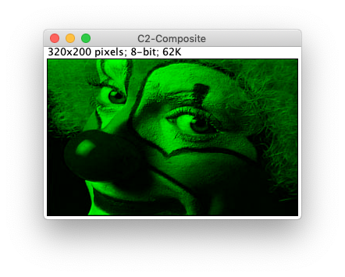
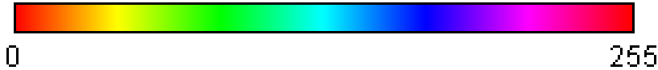
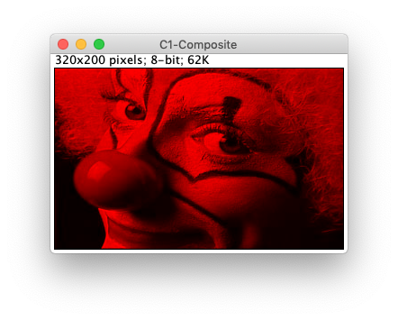
Recap: Basic Concepts
Grey level image
d
Image
Pixel Size
Pixel value, Bit depth
Histogram
Visualisation
RGB, Composite Images
LUTs
B&C
Channels tool

Slide 4
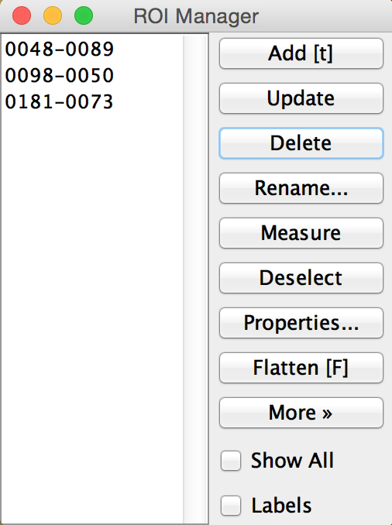
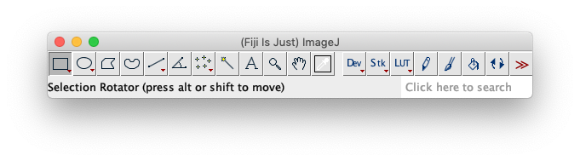
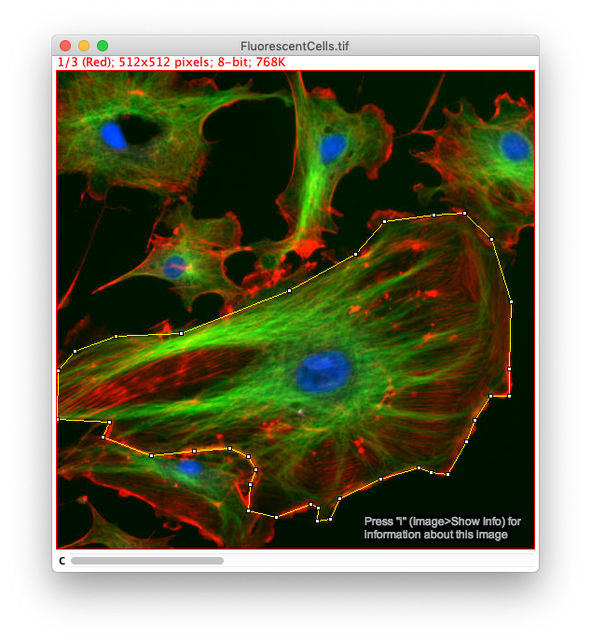
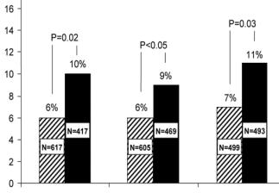
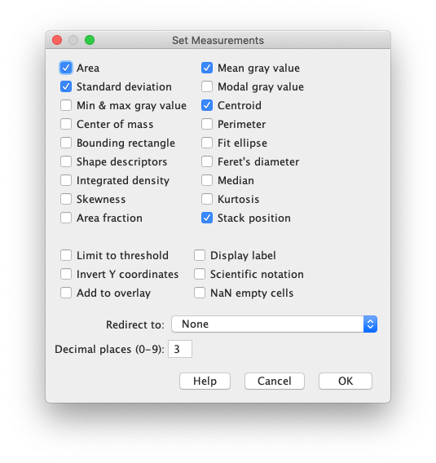
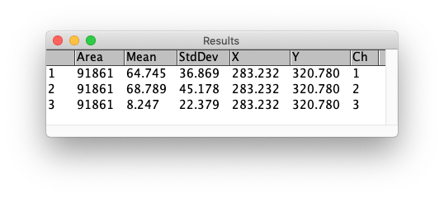
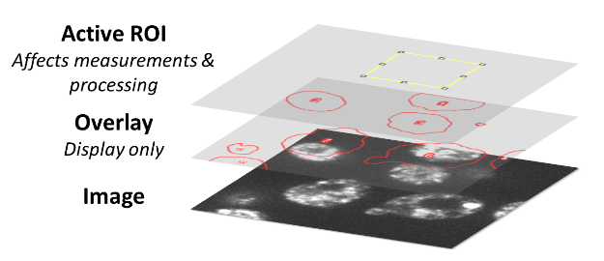
Recap: Basic Concepts
ROI manager
Measure pipeline
Overlay

Slide 5
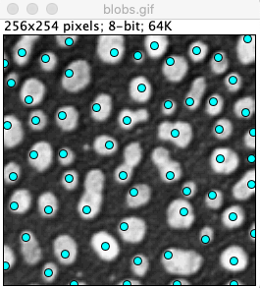
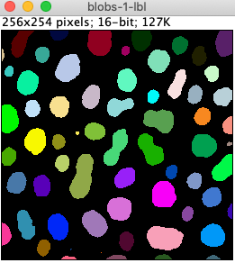
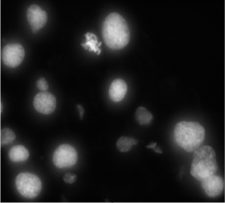
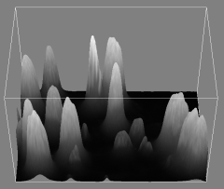
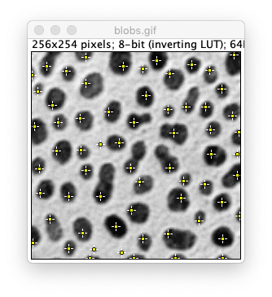
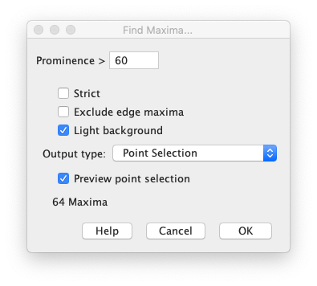
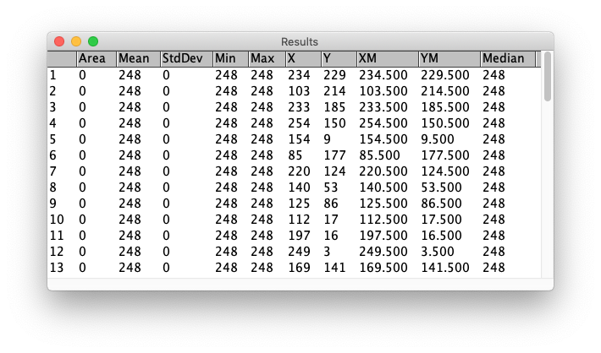
Recap: Counting objects
Detection vs Segmentation
Counting: Maxima detection
FIJI Find Maxima

Slide 6
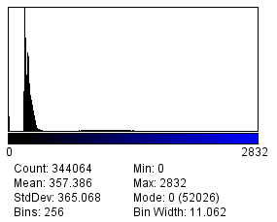
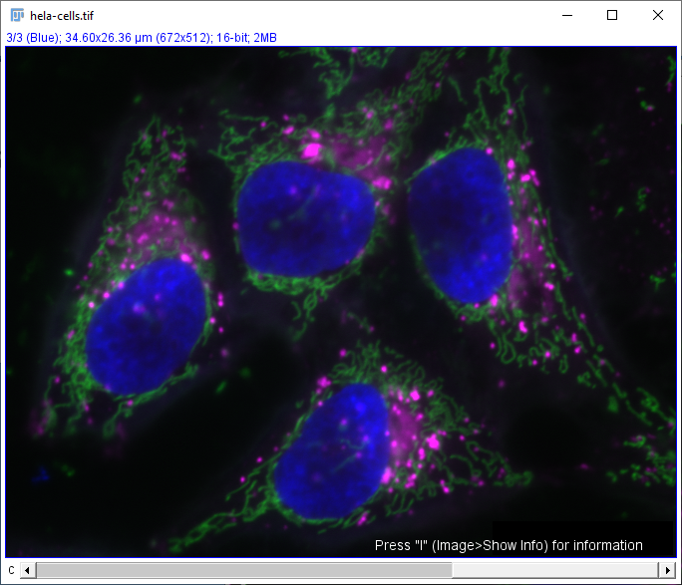
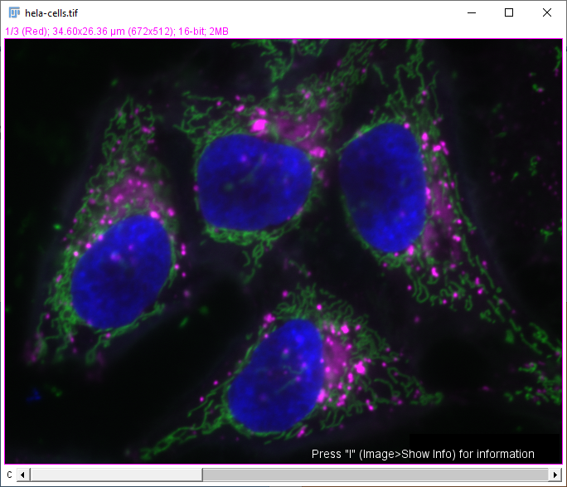
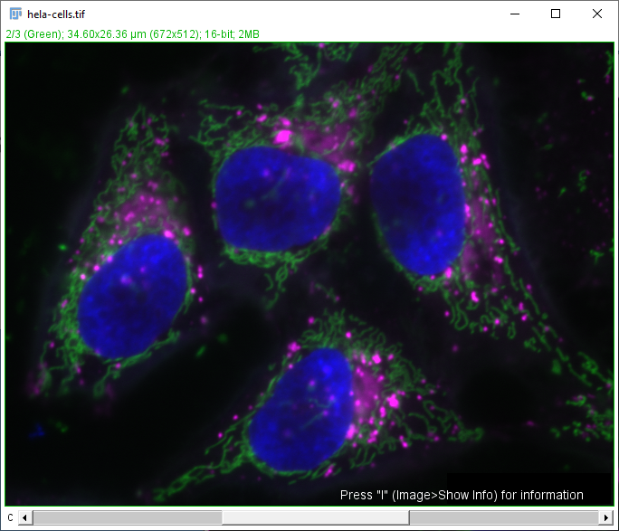
Quiz (1/2)
This histogram shows the grey value distribution of which image?

Slide 7
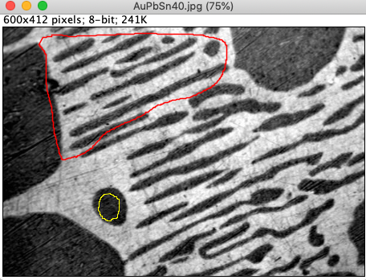
Quiz (2/2)
You have an image with an overlay in red and a Roi selection in yellow.
When you press the key M (measure), which region will be measured?
Overlay
Full image
Roi

Slide 8
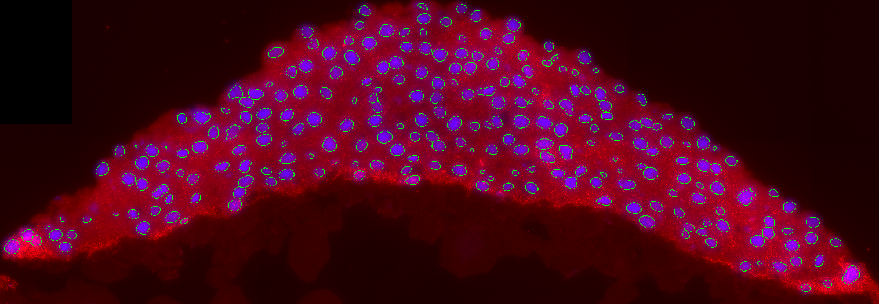
Segmentation

Slide 9
Overview
Segmentation introduction
Classic segmentation pipeline
Preprocessing, thresholding, postprocessing
Particle analysis and measurements
Application: Interactive segmentation

Slide 10
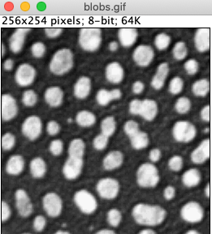
Finding Objects
Object detection
Point/Box per object
Use cases:
Counting
Tracking spots
Object segmentation
Outline per object
Uses cases:
Shape quantification
Spatial relation of objects
Notes:
Detection is easier
Spatial relation between objects: e.g. neighbors, what is inside/outside of cells

Slide 11
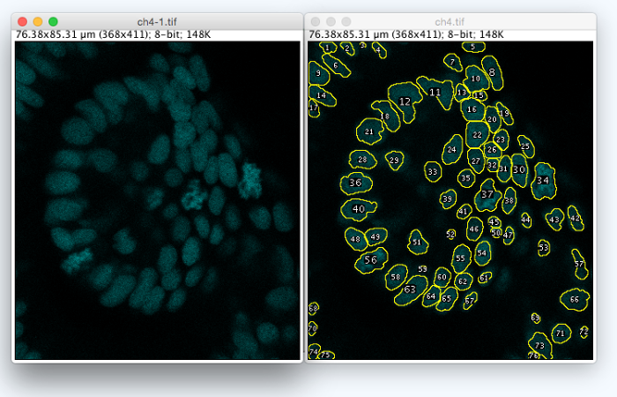
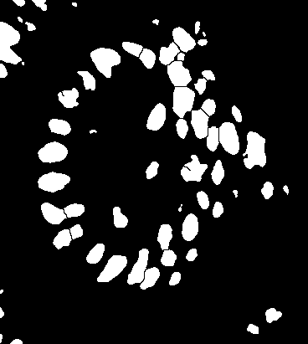
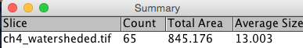
Goal
Determine the cell regions (objects) automatically and measure their properties.
Image Source: Jaydeep Sidhaye, Norden Group, MPI CBG

Slide 12
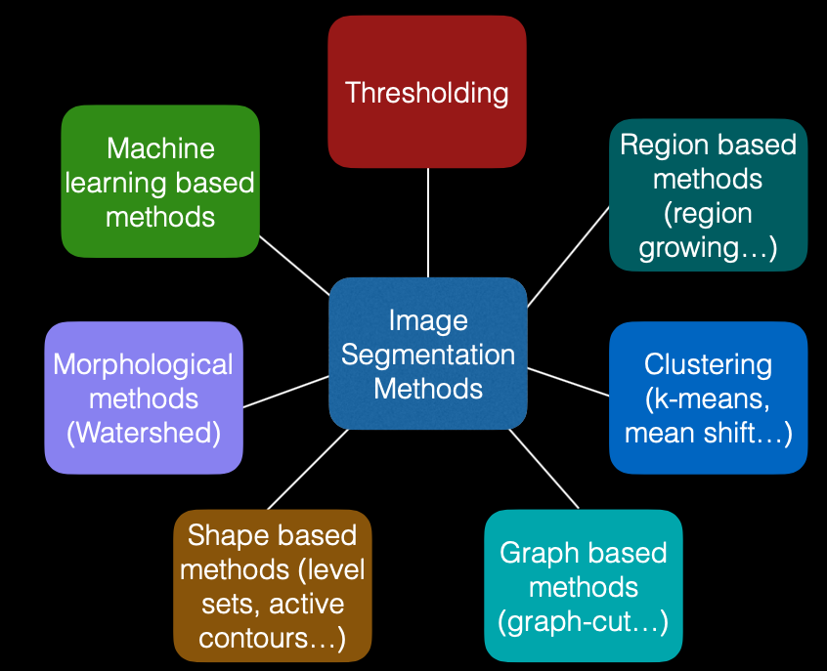
How to split an image into regions?
Many methods for segmentation exist.
Image by: Ignacio Arganda-Carreras, Biological Image Reconstruction and Analysis Course, 2016

Slide 13
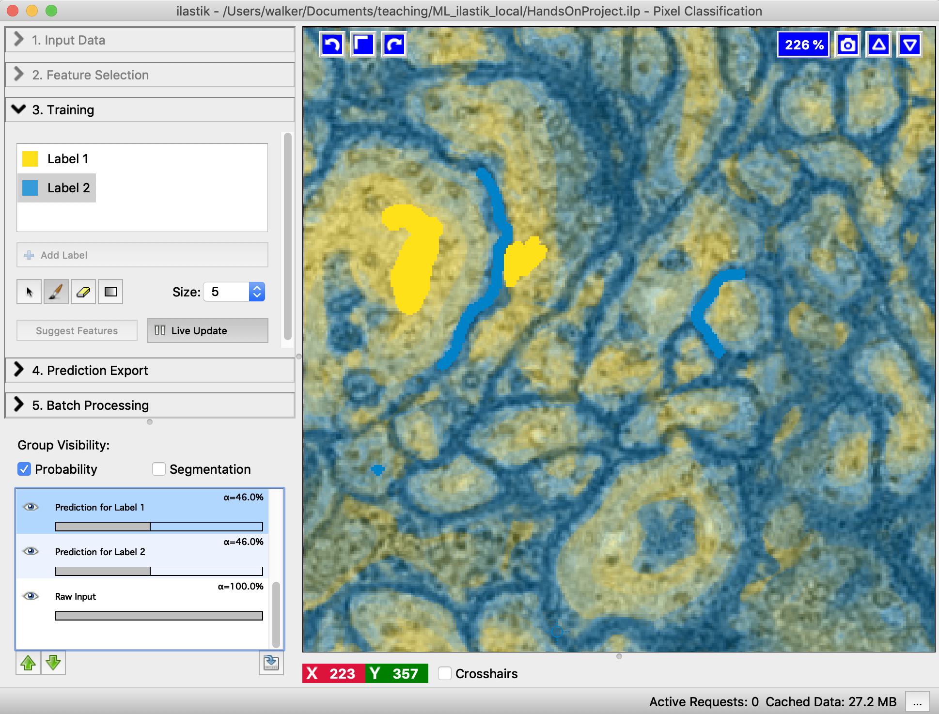
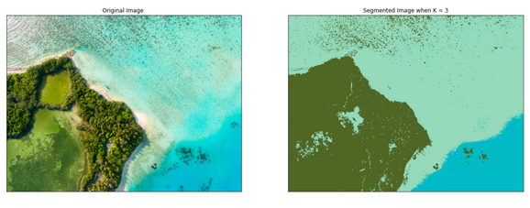
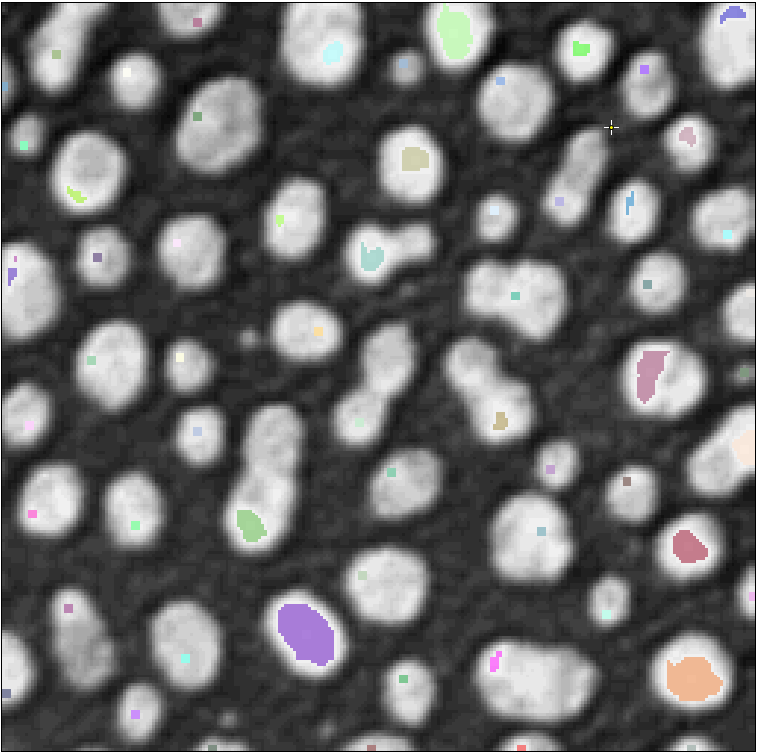
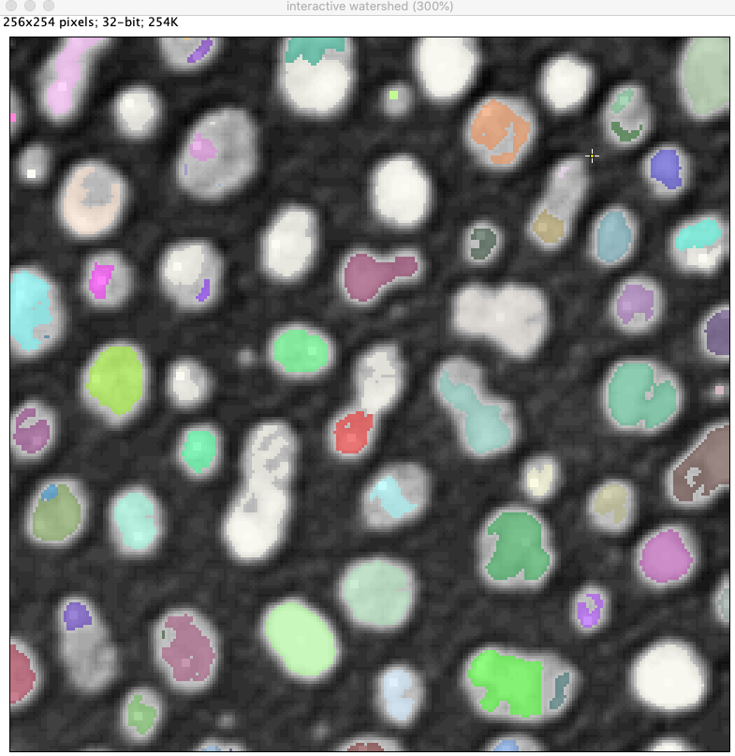
How to split an image into regions?
Examples
Thresholding
Machine learning: supervised pixel classification
Unsupervised learning: Clustering
Region growing: from seed points
Image: https://morioh.com/p/dcdc9957bc1c
Notes:
Thresholding: simple but often works
Pixel classification: also quite simple to do.
Start with red in course, then gray.

Slide 14
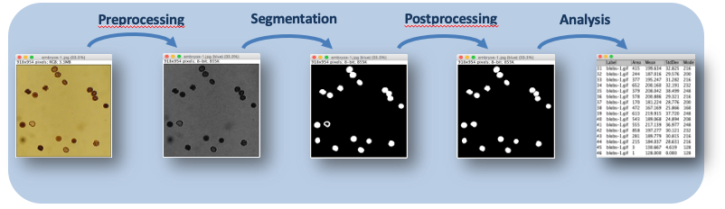
Classic segmentation pipeline

Slide 15
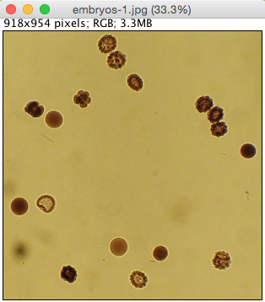
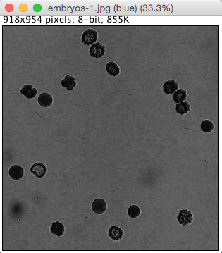
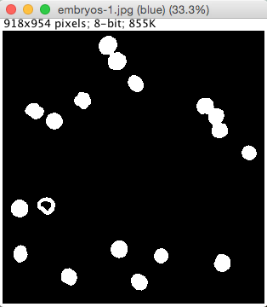
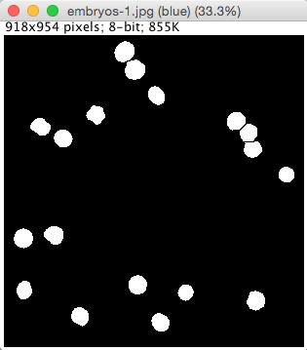
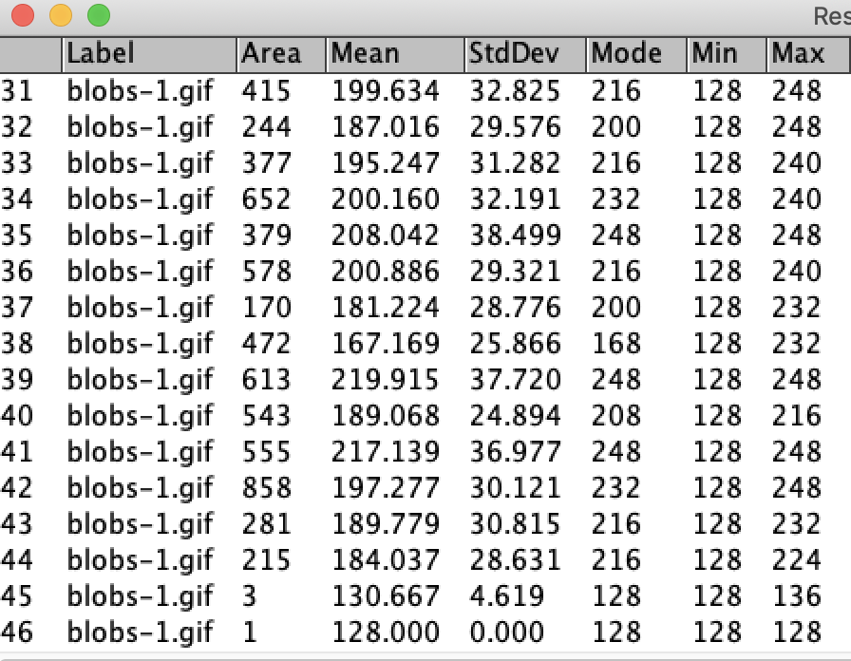
Typical pipeline
Preprocessing
Segmentation
Postprocessing
Analysis
Preprocessing
Deconvolution
Denoising/ Smoothing
Data reduction
Background correction
….
Segmentation
Thresholding
Pixel classifiers (machine learning)
Region growing
Edge based segmentation
…
Postprocessing
Morphological operations:
Watershed
Fill holes
Opening/Closing,…
…
Analysis
Counting
Measure properties
…

Slide 16
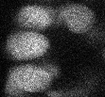
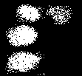


Preprocessing: Denoising
Reduce the effects of noise using Gaussian Blur
In Fiji:
Process > Filters > Gaussian blur
Or:
Process > Smooth
Thresholding
Oh no! I see thousands of white objects!
Blurring
Thresholding
Ok, it’s just 4 objects.

Slide 17
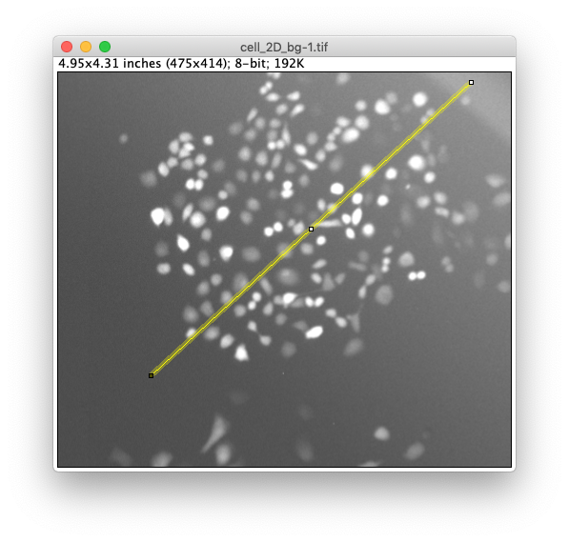
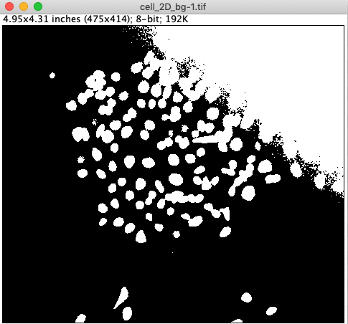
Preprocessing: Subtract Background
If the background is uneven, objects can be hard to segment.

Slide 18
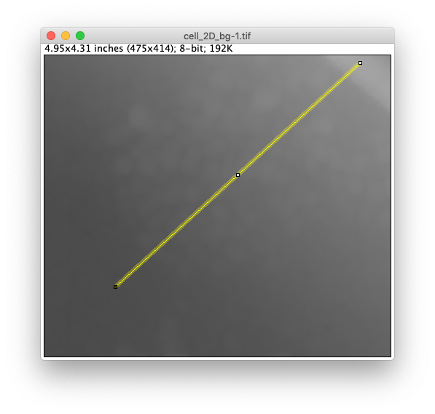
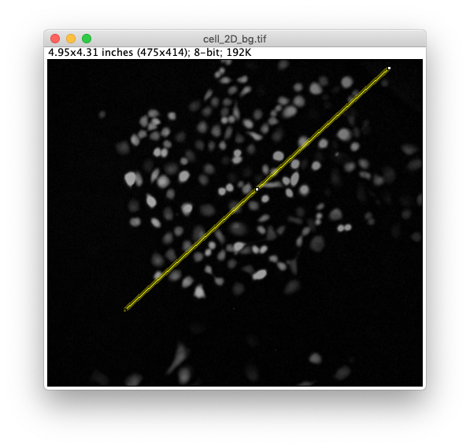



Preprocessing: Subtract Background
If the background is uneven, objects can be hard to segment.
Remove flatfield in the background.

Slide 19

Preprocessing: Subtract Background
If the background is uneven, objects can be hard to segment.
Remove flatfield in the background.

Slide 20




Subtract Background in Fiji
In Fiji:
Process > Subtract Background …
> radius of largest object to be detected

Slide 21



Thresholding
Thresholding is used to create a mask of foreground objects in an image.
It is the simplest form of segmentation.
In FIJI menu, Image > Adjust > Threshold or Cmd + shift + T
Always use an automatic method for threshold selection
-> reproducibility.
Apply creates a mask.
Switching dark background inverts the selection.

Slide 22
Demo/Hands-on
Goal: Importance of preprocessing before thresholding
Remember: Garbage in, garbage out!
Activity: Threshold image with and without background subtraction

Slide 23

Thresholding Methods
Automatic thresholding methods compute the threshold based on the image histogram.
Otsu method:
Maximize the variance between the two classes of pixels, which are separated by the threshold.
Equivalent: Minimize the variance with each class.
-> Works well for bimodal distributions.
https://scikit-image.org/docs/0.10.x/auto_examples/plot_otsu.html

Slide 24


Choosing the thresholding method
It is easy to compare all automatic thresholding methods in Fiji.
In FIJI, Image > Adjust > Auto threshold with try all checked.
Before picking your method, test it on a few of your images.
Montage
of outputs
Side note: Local thresholding:
This is a method where the threshold value is not global but changes locally.
The threshold at each pixel is computed based on the intensity in its local surrounding.
Image > Adjust > Auto local threshold: Compare methods.

Slide 25



Quiz
We have applied two thresholding methods on the image on right and the results are below.
Which method/solution do you think is better?
Input
A
B
Notes:
Answer: it depends on what is biologically relevant – for intensity measurements: best to have an independent channel for segmentation. Otherwise the segmentation depends on the threshold value
In this case: probably the right box -> detect all nuclei

Slide 26

Postprocessing: Mask cleanup
Process > Binary > Fill holes
Process > Binary > Watershed (split objects)
Process > Binary > Open [then] Close (remove small objects)

Slide 27




Postprocessing: Binary Watershed
Watershed
Split touching objects.
Model: Objects are roundish and touch at a “thin neck”.

Slide 28



Binary Watershed
The watershed algorithm for binary images allows cutting one object into two where it’s reasonable.
Binary segmentation
Distance map
Slide courtesy: Robert Haase

Slide 29


Binary Watershed
The watershed algorithm for binary images allows cutting one object into two where it’s reasonable.
The watersheds are made from binary images. The algorithm does not take the original image into account!
Binary segmentation
Distance map
Watershed
Original image
Slide courtesy: Robert Haase

Slide 30

How many regions do we have?
1 region!
14 regions
Connected component labelling
Naming conventions
Mask or Binary image or Thresholded image
Foreground (255) vs Background (0)
Label image
Each region has a unique value (background=0, cell1=1, cell2=2, etc.)
Different algorithms expect different input.

Slide 31
Measuring region properties
A segmented object can be described by many properties.
Geometric properties
Area
Centroid
Bounding box
Perimeter
Ellipsoid fit
Major & minor axis
…

Slide 32


Measuring region properties
A segmented object can be described by many properties.
Intensity properties (from original image)
Mean
Standard deviation
Median
…

Slide 33



Fiji: Set Measurements
Set the measurements before doing particle analysis.
In FIJI, Analyze -> Set Measurements
Includes option to redirect a measurement
…but take measurements (intensity etc) from this image.
Analyze these particles…

Slide 34



Fiji: Particle Analyzer
Fiji: Analyze > Analyze Particles …
?

Slide 35

Optimizing the Segmentation Pipeline
Pre-processing
Segmentation / Regionalisation
Post-processing / correction
Measurement
Results not good?
Change analysis parameters
Change imaging settings
Notes:
Recap of the pipeline

Slide 36


Add-on: ROI versus Mask (Fiji)
ROIs and Masks in Fiji can be converted into each other.
Edit > Selection > Create Selection
Edit > Selection > Restore Selection
Edit > Selection > Create Mask

Slide 37







Add-on: MorphoLibJ (Fiji)
A great library for segmentation and post-processing.
Well documented! (https://imagej.net/MorphoLibJ)
Subscribe to the update site: Help->Update…->Manage Update Sites: add IJPB-plugins
Some useful tools for post-processing:
Keep largest region
Remove small regions

Slide 38
Demo: Segmentation
Data obtained from Elnaz Fazeli, Univserity of Turku

Slide 39

Exercise: Segmentation
Segment cells, measure each cell brightness, and get cell count. (Cell_2D_bg.tif)
Preprocess with gaussian blur
Subtract background
Duplicate this image to re-use for measurements.
Threshold
Optional: Open/Close, Watershed
Set measurements (Don’t forget to redirect)
Analyze particles
Tips:
Use the search bar (key L) if you don’t find a command.
Duplicate your image regularly as backup (Cmd+Shift+D) ☺
Use the ‘Preview’ buttons
More datasets to segment:
cell_chain.png, cell_colony.tif (use Binary > Open or MorpholibJ to remove small regions)

Slide 40
Application:
Interactive segmentation

Slide 41
Interactive segmentation
Interactive segmentation can be used for:
Find good parameters before automatizing the pipeline (exploration).
Quick segmentation of a single image (exploration).
Segment difficult data.

Slide 42






Concept: Grayscale Watershed
Recap: Binary watershed
Compute distance map.
Find local peaks
Stop flooding once regions touch or an intensity threshold is reached
Binary image
Start flooding
Grayscale watershed
The peaks (or minima) are directly detected in the grayscale input image.
The input is therefore a grayscale image, not a binary image.
Notes:
Binary vs grayscale: in binary the distance map is implicitly calculated, to find local maxima

Slide 43



Segmentation with Interactive H_Watershed
(Interactive) H_Watershed plugin from SCF
Works directly on the grayscale images
Allows for interactive exploration.
In FIJI, SCF > Labeling > (Interactive) H_Watershed
Note:
Need SCF MPI CBG update site.
Preprocessing same as before.
Sample image for which our simple pipeline could fail
https://imagej.net/Interactive_Watershed

Slide 44



Interactive H_Watershed
SCF > Labeling > (Interactive) H_Watershed
Low value
High value
Seed dynamics:
Prominence of a maxima as compared to its surrounding.
Only maxima with high prominence are used as starting points for regions.
Careful: LUT is inverted in these images. This plugin locates the maxima (not minima).

Slide 45


Interactive H_Watershed
Low value
High value
Intensity Threshold:
Limits the total amount of flooding.
Pixels with values below a threshold (i.e. darker) will not be filled.

Slide 46



Interactive H_Watershed
Image
Contour
Overlay
Solid
Overlay

Slide 47


Interactive H_Watershed
Box unchecked
Box checked
MorpholibJ Region Analyzer
Plugins › MorphoLibJ › Analyze › Analyze Regions
Standard Particle Analyzer
Analyze > Analyze Particles

Slide 48


Interactive Marker-Controlled Watershed
Interactive Marker-Controlled Watershed (MorpholibJ)
User places seed-points manually (at intensity minima!)
Grayscale watershed: Image is flooded from the seed points
In FIJI, Plugins › MorphoLibJ › Segmentation › Interactive Marker-controlled Watershed
Note:
Need IJPB-plugins update site.
Preprocessing same as before.
https://imagej.net/Interactive_Marker-controlled_Watershed

Slide 49

Exercise: Interactive Segmentation
Segment the cells in cells Drosophila_2D_Race_inverted.tif .
Duplicate the image
Do you need some preprocessing?
Use Interactive H_Watershed: SCF > Labeling > (Interactive) H_Watershed
Analyze the segmented image.
Measure for each cell its average intensity (from the input image):
Use either Particle Analyzer: Analyze > Analyze Particles …
Or Region Analyzer: Plugins › MorphoLibJ › Analyze › Analyze Regions
Make sure you have the right input image for the analyzer tool.

Slide 50




Summary
Region segmentation
Watershed: split regions
Binary image
Labels
Classic segmentation pipeline
Preprocessing
Segmentation
Postprocessing
Analysis

Slide 51

Concepts:
Filters, Morphological operations

Slide 52
Overview
Mathematical background for operations on images
Image filters
Linear filters (convolutions)
Nonlinear filters
Morphological operations
Image math
Calculations with images

Slide 53
Image Filters

Slide 54


Spatial filters
An image processing filter is an operation on an image.
Filters change pixel values.
Filters do not do magic. They can not make things visible which are not in the image.
Application examples
Noise-reduction
Artefact-removal
Contrast enhancement
Correct uneven illumination
We already used several filters in the previous segmentation pipeline.
Image source: Mauricio Rocha Martins (Norden/Myers lab, MPI CBG)

Slide 55

Example: Noise removal with filters
Linear filter
Nonlinear filter
Original image
Gaussian blur filtered
Median filtered
Image source: Mauricio Rocha Martins (Norden/Myers lab, MPI CBG)

Slide 56

Linear Filters
Linear filters replace each pixel value with a linear combination of surrounding pixels
Basically, linear filtering is a Convolution
It needs a kernel (weight template)
Result: new image where each pixel is replaced by the weighted sum of pixel values in the neighbourhood.
Kernels are matrices describing a linear filter.
1/9 | 1/9 | 1/9
1/9 | 1/9 | 1/9
1/9 | 1/9 | 1/9
Mean filter, 3x3 kernel
1/16 | 1/8 | 1/16
1/8 | 1/4 | 1/8
1/16 | 1/8 | 1/16
Gaussian filter, 3x3 kernel
Animation source: Dominic Waithe, Oxford University
https://github.com/dwaithe/generalMacros/tree/master/convolution_ani

Slide 57





Linear Filters
Terminology:
“We convolve an image with a kernel.”
Convolution operator: *
Examples
Mean
Gaussian blur
Sobel-operator
X/Y-Gradient
1 | 1 | 1
1 | 8 | 1
1 | 1 | 1
=
*
-1 | 0 | 1
-2 | 0 | 2
-1 | 0 | 1
=
*
Total gradient:

Slide 58


Linear Filters in Fiji
Linear filters:
Gaussian blur
Mean
* Smooth is a 3x3 Mean filter
Convolve…
Allows us to specify our kernel
*

Slide 59

Nonlinear Filters
Non linear filters also replace pixel value inside a rolling window but in a non linear function.
Examples: order statistics filters
Min
Median
Max
Variance
Standard deviation
75 | 85 | 60
67 | 73 | 91
50 | 88 | 59
[ 50 59 60 67 73 75 85 88 91 ]
Min
Median
Max

Slide 60


Nonlinear Filters in Fiji
Examples:
Min
Median
Max
Variance

Slide 61



Edge detection filter
Edge detection might make sense to measure surfaces or follow structures which are located between bright and dark structures.
Median filter+ Edge detection
nuclear envelope marked with Lap2b-GFP
+ median filter
Microscopists may know fancy alternatives to computational edge detection.
Fiji: Process > Find Edges …
Image source: Mauricio Rocha Martins (Norden/Myers lab, MPI CBG)

Slide 62
Morphological operations

Slide 63


Morphological operations
Morphological operations are image filters which are used on binary masks.
Goal: Improve the binary mask.
Some of the morphological operations:
Dilation
Erosion
Opening
Closing
Watershed
Fill holes
We already used several morphological operations in the previous segmentation pipeline.
Slide adapted from: Elnaz Fazeli, University of Turku

Slide 64

Dilation
Dilation
Dilation: Grows regions.
If any pixel in the neighborhood is white, then the central pixel is converted to white.
Gray value equivalent: Maximum
8-connected
neighborhood
4-connected
neighborhood
https://www.edx.org/course/image-processing-and-analysis-for-life-scientists
Slide courtesy: Elnaz Fazeli, University of Turku
Notes:
Colors just for illustration: we only have black and white pixels

Slide 65
Erosion
Erosion
Erosion: Shrinks regions.
If any pixel in the neighborhood is black, then the central pixel is converted to black.
Gray value equivalent: Minimum
Slide courtesy: Elnaz Fazeli, University of Turku

Slide 66
Refining masks: Erosion & Dilation
Erosion and dilation combined allow correcting outlines.
Erosion
Dilation
“Opening”

Slide 67








Refining masks: Erosion & Dilation
Morphological filters can be combined in many ways:
Erosion: Set all pixels to black which have at least one black neighbor.
Erosion
Erosion
Erosion
Dilation: Set all pixels to white which have at least one white neighbor.
Dilation
Dilation
Dilation
Closing: Dilation + Erosion
Dilation
Erosion
Opening: Erosion + Dilation

Slide 68
Quiz (1/2): Morphological Operations
Assuming white pixels have value 1 and black pixels have value 0.
With which filter is the Erosion filter in this context identical?
Tip: Check what the influence of the neighborhood (green) on a single pixel (red) is when updating it.
0
0
0
0
0
0
0
0
0
0
0
1
1
1
0
0
0
0
0
0
0
1
1
1
0
Erosion
0
0
1
0
0
0
1
1
1
0
0
0
0
0
0
0
0
0
0
0
0
0
0
0
0
Mean
Minimum
Maximum

Slide 69
Quiz (2/2): Opening / Closing
Dilation
Erosion
How is the combination of dilation + erosion called again?
Opening
Closing

Slide 70



More morphological operations
Distance Map
Binary Watershed
Skeletonize
Fill holes
….
Binary segmentation
Distance map
Watershed

Slide 71

Morphology in Fiji
Mask
+ filled holes
+ Watershed

Slide 72
Image math

Slide 73




Background removal
Differentiating objects is easier if their background intensity is equal.
Depending on the effect we want to correct for, it might make sense to divide an image by its background instead of subtracting it.
-
=
This is roughly what the Fiji “Subtract Background…” is doing.
Original image
Extracted background
Subtracted background
/
=
Image source:
Mauricio Rocha Martins (Norden/Myers lab, MPI CBG)
Original image
Extracted background
Image divided by background
Notes:
This is a mathematical

Slide 74





Mathematical operations on images
It might be hard to differentiate objects from single images…
Segmentation of nuclei can be improved by subtracting a channel visualizing nuclei envelope from the nuclei channel.
-
=
Image source: Mauricio Rocha Martins (Norden/Myers lab, MPI CBG)

Slide 75






Mathematical operations on masks
And
Or
Notes:
Can write logical operations if necessary on the screen

Slide 76




Image math in Fiji
Fiji: Process > Image Calculator
Use the Image Calculator to subtract, add, multiply or divide images.
Image source: Mauricio Rocha Martins (Norden/Myers lab, MPI CBG)

Slide 77




Math with numbers + images in Fiji
All basic math operations for pixels are available in ImageJ/Fiji.
If you want to simulate a binary image: Select some black pixels and add 255 to make them white.

Slide 78




Demo
Morphology
Use image: nuclei_transcripts_zebrafish_zoom_1ch.tif
Thresholding
Erosion, Dilation
Distance Map
Use image: mask1.tif
Distance transform for original and inverted image
Image calculator: Combining masks
Use images: mask1.tif, mask2.tif
AND, OR

Slide 79
Exercise: Filters
Open the example zfish_retina.tif in Fiji.
Image > Colour > Split channels
Play with linear and non-linear filters in the menu Process > Filters.
Change the radius parameter. Enter 1, 2, 5, and 50!
Compare Smooth and Gaussian Blur… what’s different?
*
Original image
Gaussian blur filtered
Median filtered
Image source: Mauricio Rocha Martins (Norden/Myers lab, MPI CBG)

Slide 80



Exercise: Distance Map
Compute the distance of the spots to the nucleus.
Open nuclei_transcripts_zebrafish_zoom.tif.
Split channels.
Segment the nucleus.
Detect the spots.
Measure their distance to the nucleus region.
Tips: Thresholding, Maxima detection, Distance map/transform
Notes:
EXTRA

Slide 81



Exercise: Image calculator
Process the image “zfish_retina.tif” using
Background subtraction
Image Calculator
Goal: Optimize differentiation between cells.
Then create a segmentation mask.
Subtraction
Background subtraction (radius = 25)
Image source: Mauricio Rocha Martins (Norden/Myers lab, MPI CBG)

Slide 82




Optional Exercise: Making your own filters
Open zfish_retina.tif
Split the channels.
Make your own filter kernels!
Use the menu Process > Filters > Convolve…
1 | 1 | 1
1 | 8 | 1
1 | 1 | 1
1 | -2 | 1
1 | -2 | 1
1 | -2 | 1
1 | 1 | 1
-2 | -2 | -2
1 | 1 | 1
-1 | -1 | -1
-1 | 8 | -1
-1 | -1 | -1
Image source: Mauricio Rocha Martins (Norden/Myers lab, MPI CBG)

Slide 83
Summary
Image Filters
Morphological Operations
Image Math

Slide 84


Segmentation methods
Segmentation with thresholding is a simple pipeline and often works.
Recall that also many segmentation other methods exist.
Examples:
Pixel classification with (shallow) Machine Learning
-> powerful
-> next session
Deep Learning (Neural nets)
Examples: StarDist, CellPose
-> very powerful
Notes:
From simple to more complex methods
But the 2 nnet examples are very usable

Slide 85

Advanced segmentation: StarDist
“StarDist”
a neural net for segmenting roundish, dense objects (like nuclei)
Pretrained net available as Fiji plugin (2D, 2D+t):
Plugins > StarDist > StarDist 2D
https://imagej.net/StarDist
Tips:
Read the documentation
Nuclei appearance and size should be similar to training data (~20px)
For 3D: use python
Notes:
Why doc? Powerful tool but important to know what it’s been intended for

Slide 86


Advanced segmentation: CellPose
“CellPose”:
a neural net for segmenting dense cells of a wide variety of shapes: nuclei and cytosols
Availability:
Standalone GUI & python package (2D, 3D)
For quick exploration: check out the website: http://www.cellpose.org/
Tips:
Read the documentation

Slide 87
Optional Exercise: StarDist, Cellpose
Segment a nuclei image with StarDist in Fiji. (AS_09125_050116000001_L15f00d0_slice1_channel1.tif)
Optional: Try segmentations at http://www.cellpose.org/

